Slide 1

CS 470 Project Two Conference Presentation: Cloud Development
Jason Veno
October 2023

Slide 2
Overview
Jason Veno: SNHU Computer Science Major, current Manufacturing Data Administrator, trains in Mixed Martial Arts.
This presentation will attempt to articulate the intricacies of cloud development to both technical and nontechnical audiences.
Notes:
My name is Jason Veno, I’m right about to graduate from SNHU with a Bachelor’s in Computer Science with a concentration in Software Engineering. I currently work at a pharmaceutical company as a Manufacturing Data Administrator where I get to oversee and assist with the database, as well as automate various processes by writing macros and scripts. I am also trained in Mixed Martial Arts in case I have to defend the data from cyber threats.
This presentation will attempt to articulate the intricacies of cloud development to both technical and nontechnical audiences. This means that we will delve into everything related to cloud development, from the tools used to the purpose it serves. This presentation will also attempt to disclose this info to those of us who are well-versed on cloud development, and those who are not.

Slide 3
Containerization
The models used to migrate a full stack application to the cloud include rehosting, refactoring, repurchasing, and more.
Containerization tools bundle an application’s code with all the files needed to run on any infrastructure. They include Docker, AWS and more.
Notes:
The models used to migrate a full stack application to the cloud include rehosting (which is lifting the stack to the cloud), refactoring (which is rebuilding the stack for cloud capabilities), repurchasing (which is moving the stack to a cloud-native product, usually a SaaS platform), and much more.
Containerization tools bundle an application’s code with all the files needed to run on any infrastructure. This can be thought of like packing everything on your shelf in a cardboard box, so you can be sure that everything on the shelf stays together when you move. These tools include Docker, AWS (Amazon Web Services) and more.

Slide 4
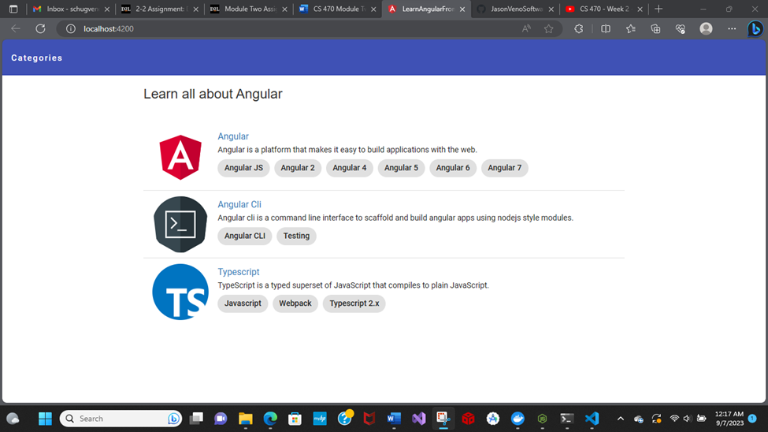
Orchestration
Docker Compose is an intuitive tool that allows you to containerize and share multi-container applications via YAML files.

Slide 5
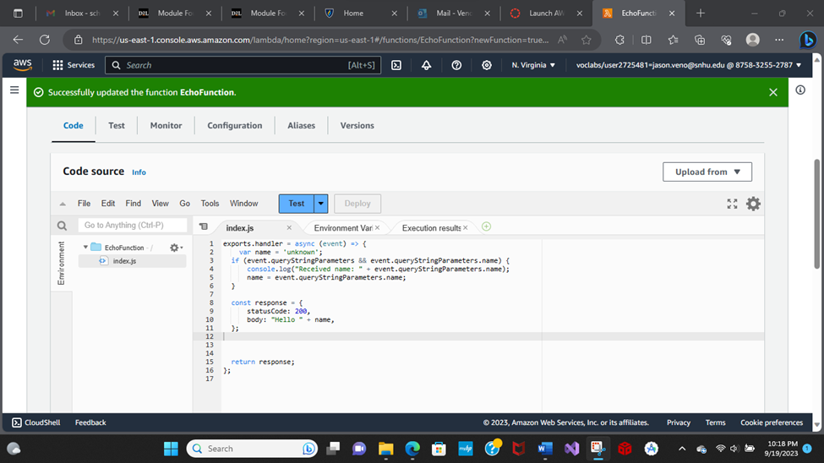
The Serverless Cloud
Serverless
Serverless is a cloud-native development model that allows developers to build and run applications without having to manage servers, allowing for the “servers” to automatically scale up and down as needed.
Amazon Simple Storage Service (Amazon S3) is an object storage service that allows users to store and retrieve large amounts of data in a variety of ways.
Notes:
“Serverless” means without servers, but that’s not entirely true. The servers are just in a different location, and are able to be sold in certain increments, which ensures that customers only purchase the exact amount of storage they need, no more and no less. One example of this is Amazon Simple Storage Service.

Slide 6
The Serverless Cloud
API & Lambda
Serverless API Advantages:
No server Management
Scalable
Less expensive
Much more
Lambda API Logic refers to the use of Lambda functions to handle API requests and return responses.
Scripts include those that scan tables, get records, upsert rows, etc.
To integrate the frontend with the backend, you must:
Implement the frontend and the backend
Define and test the API
Connect the frontend and the backend via the API
Notes:
Serverless API is a scary concept with a surprisingly simplistic application. It is superior in almost every way, including no longer needing to manage the server, being fully scalable, being less expensive overall, and much more. Lambda API Logic refers to the use of Lambda functions to handle API requests and return responses, and requires the use of several scripts, including those that scan tables, get records, upsert rows (which means to update or insert the row depending on if it exists or not), and so on. This is all accomplished by first integrating the frontend with the backend, which is done by implementing the frontend and the backend, defining and testing the API, and connecting the frontend and the backend through the API.

Slide 7
The Serverless Cloud
Database
Differences between MongoDB and DynamoDB:
MongoDB is document-based
DynamoDB is key-value based
Queries differ between the two: MongoDB allows queries like Find() to filter specific data, while DynamoDB requires key conditions.
Notes:
MongoDB is document based, while DynamoDB is key-value based. This leads to differences in data structure, querying, and more. For example, you can’t query in DynamoDB the same way because key conditions are required.

Slide 8
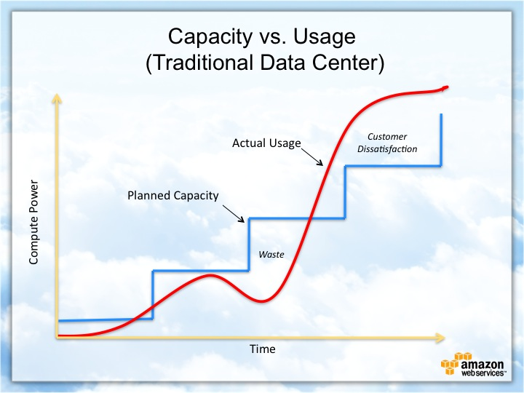
Cloud-Based Development Principles
Elasticity refers to an application’s ability to resize itself depending on how its scaled.
Pay-for-use model is the model of charging customers for how much storage space they actually use.
Notes:
Elasticity refers to an application’s ability to resize itself depending on how its scaled. This includes resources like figuring, stockpiling and organization assets.
Pay-for-use model is the model of charging customers for how much storage space they actually use. This prevents things like overspending, running out of storage, and more.

Slide 9
Securing Your Cloud App
Access
Policies
API Security
Authentication and Authorization
Principle of Least Privilege
Roles are created and defined by their permissions
API Gateway authorizers and Access Management all allow for optimal security
Regular updates also help
Bucket policies can make all the difference
Notes:
To keep your cloud app secure, authentication and authorization work well, but the principle of least privilege works best. This involves simply giving each user the minimum level of access required to perform their given task. Each role a user could have is defined and separated by their permissions, thus reducing the chances of giving unnecessary access to something. For further API security, consider gateway authorizers, access management, regular updates, and bucket policies.

Slide 10
Conclusion
Serverless:
Fixed price (subject to change)
Can scale automatically
Pay-for-use-model:
Not a fixed price
Must be configured when customer needs change
Comparisons:
Both take away the need to manage your own server
Both only require application code
Both offer extreme precision during scaling
Thank you for your time.
Notes:
I wanted to conclude this presentation by specifying the differences between the serverless model and the pay-for-use model. The serverless model is a fixed price that can change periodically if the need arises, while the pay-for-use model changes its cost depending on how much storage is used. Because of this, the serverless model can scale automatically, while the pay-for-use model must be monitored to ensure that scaling is appropriate and customers pay accordingly. There are a few comparisons to keep in mind as well, such as how both take away the need to manage your own server, both only require application code, and both offer extreme precision during scaling. Thank you for your time.

